Slide 1
NSQ1, Session 3
MongoDB introduction

Slide 2
Document databases
MongoDB is a document database
A document database contains formatted documents
Textual formats
Representing an object graph
Object document formats
JSON
XML
YAML
MongoDB uses
JSON as the interface format
BSON (= binary JSON) as the internal representation

Slide 3
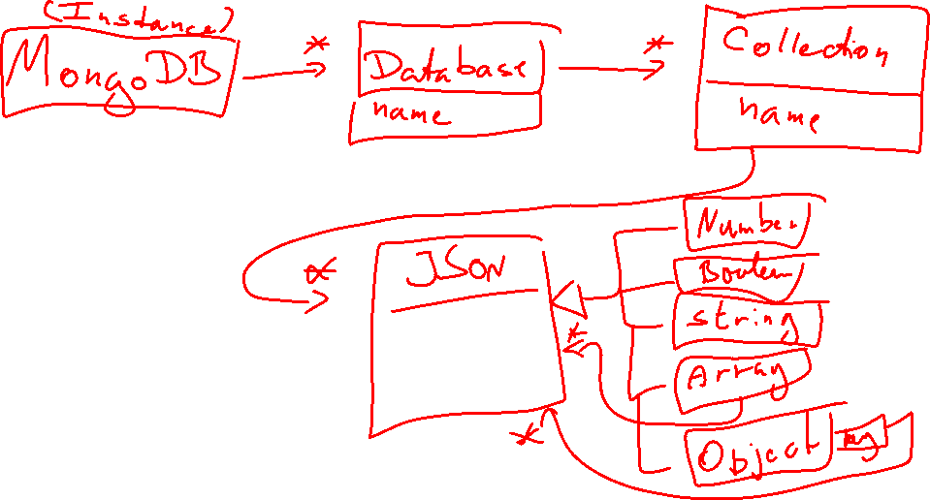
Model of MongoDB

Slide 4
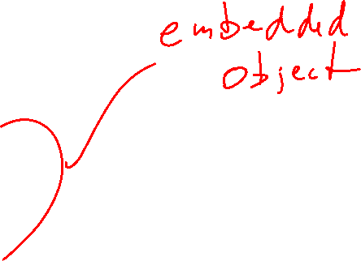
Object Graph as JSON
{
"name": "John Doe",
"phone": "123456789",
"address": {
"street": "Broad Street",
"number": "1111",
"zip": 67890
}
}

Slide 5
From ER-model to logical model
In relational model:
9-step algorithm with little to no leeway
Result can be logical model: User(id, name, …) Primary key(name)
Result can be global relations diagram
Focus on consistency and avoiding redundancy
In MongoDB:
A series of modelling choices using some guidelines
Result does not have a standard format
Focus on making pragmatic solutions

Slide 6
MongoDB modelling
Model by example (common)
Structure only (common)
User: { name: ‘John Doe’, email: ‘john@doe.com’, address: [{
type: ‘work’, street: ‘Banegårdsgade’,
number: 2,
city: {
name: ‘Horsens’,
zip: 8700
}
}]
}
User: { name, email, address: [{
type, street,
number,
city: {
name,
zip
}
}]
}

Slide 7
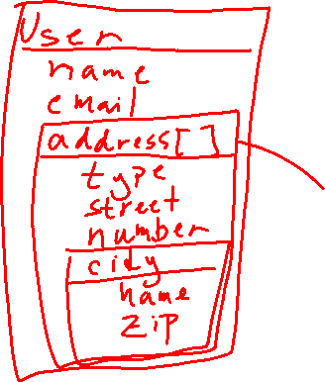
MongoDB modelling
Structure with type:
Visual style
User: { name: string, email: string, address: [{
type: string, street: string,
number: int,
city: {
name: string,
zip: int
}
}]
}

Slide 8
Modelling Principles
“The optimal grouping of objects into collections is determined by the workload.” - Jay Runkel, Distinguished Solutions Architect, MongoDB
Nothing is wrong, but everything has consequences
The choice of embedding is determined by queries and how frequent they are
Data that's retrieved together should be stored together
Data that's not retrieved together should not be stored together
Redundancy is okay, but only when needed

Slide 9
Modelling guidelines 1-1
Relational
User(name, email, street, number)
MongoDB
{ name,
email,
address: {
street,
number
}
}

Slide 10
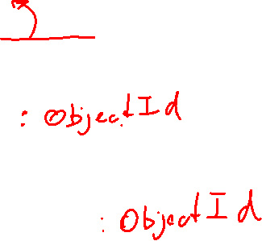
Modelling guidelines 1-* (1/4)
Relational
Event(id, time)
Ticket(event_id, price)
MongoDB
Event: {
_id,
time
}
Ticket: {
event_id,
price
}
}

Slide 11
Modelling guidelines 1-* (2/4)
Relational
Event(id, time)
Ticket(event_id, price)
MongoDB
Event: {
time,
tickets: [ticket_id, ticket_id, …]
}
Ticket: {
_id,
price
}
}

Slide 12
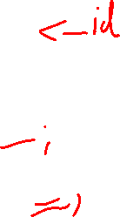
Modelling guidelines 1-* (3/4)
Relational
Event(id, time)
Ticket(event_id, price)
MongoDB
Event: {
time
}
Ticket: {
price,
event: {
time
}
}
}

Slide 13
Modelling guidelines 1-* (4/4)
Relational
Event(id, time)
Ticket(event_id, price)
MongoDB
Event: {
time,
tickets: [
{
price
}, …
]
}

Slide 14
Modelling guidelines *-* (1/2)
Relational
PerformerEvent(p_id, e_id)
MongoDB
Event: {
time,
performers: [p_id, ...]
}

Slide 15
Modelling guidelines *-* (2/2)
Relational
PerformerEvent(p_id, e_id)
MongoDB
Event: {
time,
performers: [
{ name },
...
]
}

Slide 16

BSON
Binary JSON
Data stored as BSON for disk efficiency
BSON types
double, int, long, decimal
string
bool
date, timestamp
object
array
…

Slide 17
Primary Key
All documents (but not embedded objects) have a primary key
The primary key is always _id
If you don't provide a primary key, you will get an artificial one
The BSON type is ObjectId

Slide 18
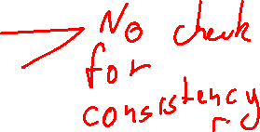
Creating a collection
db.createCollection(“mycollection”, ...)
Or just start inserting data (without creating first)
db.mycollection.insertOne({name: "", address: ""})
db.mycollection.insertAll([ {name: "", address: ""}, {fullName: "", "street address": ""} ])

Slide 19
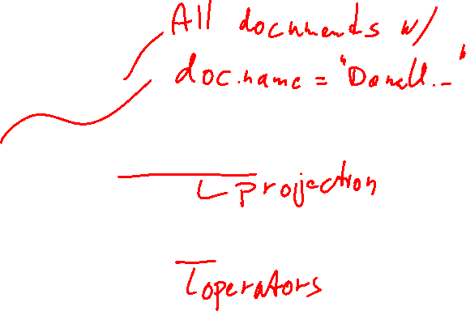
find()
db.mycollection.find({name: "Donald Duck"})
db.mycollection.find({name: "Donald Duck"}, {address: 1})
db.mycollection.find({name: "Donald Duck", age: {$gt: 30}})
More examples in the code

Slide 20
Code
example.mongodb

